Slide 1
Chapter 5
Algorithms
【See Chap.6 in the textbook】

Slide 2
5.1 Testing for primality
Prime: A positive integer n is prime if it has exactly two positive divisors, which are always itself and 1.
For example, 23 is prime, 35 is not prime.
You can determine whether n is prime by following these steps:
  1. Check each number between 1 and n to see whether it divides evenly into n.
  2. Add 1 to a running count each time you encounter a new divisor.
  3. Check to see whether the divisor count is 2 after all numbers have been tested.

Slide 3
A Simple version of IsPrime
FIGURE 5-1 Simple implementation of IsPrime
bool IsPrime (int n)
{
int divisors, i;
divisors = 0;
for (i = 1; i <= n; i++) {
if (n % i == 0) divisors++;
}
return (divisors == 2);
}

Slide 4
Verifying that a strategy represents an algorithm
The requirements imposed on algorithms:
  1. Clear and unambiguous in its definition.
  2. Effective, in the sense that its steps are executable.
  3. Finite, in the sense that it terminates after a bounded number of steps.

Slide 5
Verifying that a strategy represents an algorithm
The IsPrime function meets each of these conditions:
  1. The programming language definition specifies a precise interpretation. The semantics of programming languages are much more rigid than the semantics of human languages, it is easier to meet the first condition when the algorithm is presented in program form.
  2. The semantics of the C programming language assign meaning to each of the constructs in the program, and the compiler generates the necessary instructions for the machine to execute.
  3. The only long-running component of the function is the for loop. From the control line, you know that the loop will go through exactly n cycles each time the function IsPrime is called. If n is very large, the function my take a long time, but it must return eventually.

Slide 6
Demonstrating the correctness of the IsPrime algorithm
Proving that an algorithm is correct is very hard to do in any formal way. It is possible to outline the general direction of such a proof in the case of the IsPrime implementation.
Think about the meaning assigned to the variable divisors in the program. In each cycle of the for loop, divisors records the number of divisors encountered up to that point…
A property that is true at the initial entry to a loop and that continues to be true at the end of each loop cycle is called a loop invariant.
For certain simple programs, you can most easily establish the correctness of the program by demonstrating that the appropriate loop invariant is maintained. For more complicated programs, proving correctness can be quite difficult. In those cases, you will have to rely on less formal methods to determine whether your program is in fact delivering the correct answers.

Slide 7
Demonstrating the correctness of the IsPrime algorithm
Two methods to increase your confidence in the correctness of a program:
——Desk-checking： Go through the code step by step and convince yourself that it behaves as you intended it to behave.
—— Testing: Run your program on as many test cases as you can to check that it performs correctly for each of those cases.
Completely rigorous testing is almost certainly impossible. There are just too many cases to test.
—— Edsger Dijkstra：testing can reveal the presence of errors, but never their absence.

Slide 8
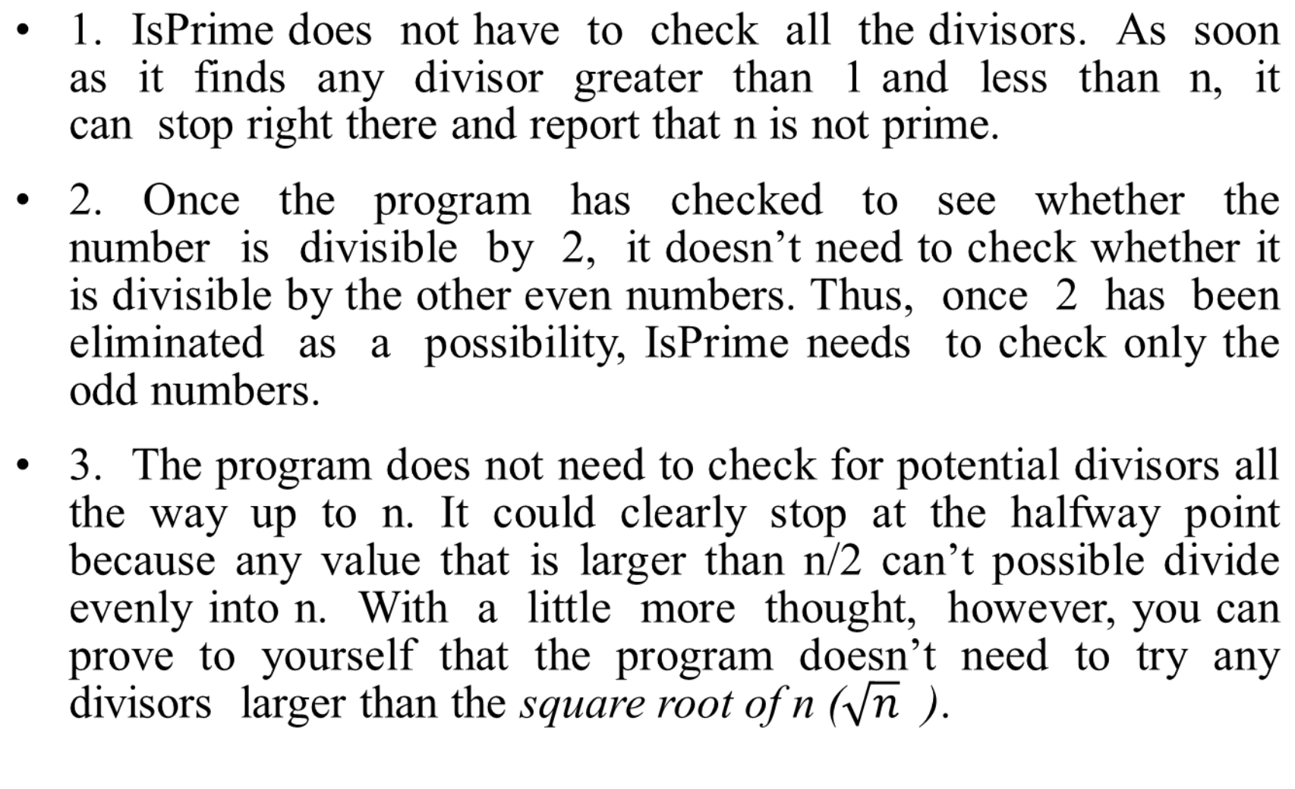
Improving algorithmic efficiency

Slide 9
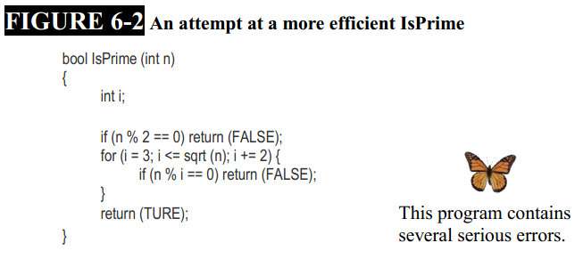
Improving algorithmic efficiency

Slide 10
Improving algorithmic efficiency
Fix Several bugs:
1. Check for 1 and 2 explicitly by inserting the following lines at the beginning of the program:
  if (n <= 1) return (FALSE);
  if (n == 2)return (TRUE);
2. The effective problem in this case is subtle and lies in the for loop control line:
  for (i = 3; i <= sqrt (n); i += 2)
  Can be replaced with the following statements:
  double limit;
  limit = sqrt (n);
  for (i = 3; i <= limit; i += 2)

Slide 11
Improving algorithmic efficiency
Fix Several bugs:
3. The implementation has another problem that is even harder to see:
  limit = sqrt (n);
The correctness of the implementation depends on the how the hardware performs floating-point arithmetic.
  To avoid the error , a better statement can be replaced with the following:
  limit = sqrt (n) + 1;

Slide 12
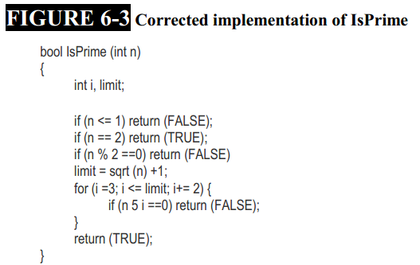
Improving algorithmic efficiency

Slide 13
Choosing between alternative implementations
The final version is considerably more efficient, and this efficiency will likely be of significant interest to anyone who needs to use this function as part of a larger application.
The original version has advantages too. In particular, the first version of the program is much more readable, and it is much easier to see that the results produced by that implementation will conform to the definition of prime numbers. The extra complexity of the final version is reflected in the fact that it was much harder to get it working.
To choosing an algorithm for a particular problem, several factors must be considered as following orders:
1. The primary concern is correctness.
2. Several other factors: efficiency, clarity, and maintainability.

Slide 14
5.2 Computing the greatest common divisor
Given two numbers, x and y, the greatest common divisor (or GCD fro short) is the largest number that divides evenly into both.
The prototype for this function is therefore
int GCD (int x, int y);
As with the primality testing algorithm, several solution strategies are available for this problem.

Slide 15
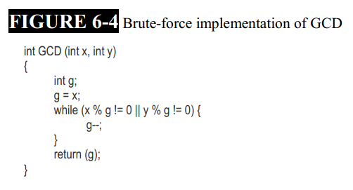
Brute-force algorithms

Slide 16
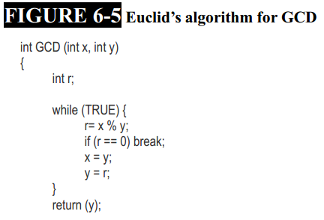
Euclid’s algorithm
  1. Divide x by y and compute the remainder; call that remainder r.
  2. If r is zero, the procedure is complete, and the answer is y.
  3. If r is not zero, set x equal to the old value of y, set y equal to r, and repeat the entire process.

Slide 17
Comparing the efficiency of the GCD algorithms
Consider the numbers 1,000,005 and 1,000,000.
To find the GCD of these two numbers, the brute-force algorithm requires a million steps; Euclid’s algorithm requires only two. At the beginning of Euclid’s algorithm, x is 1000005, y is 1000000, and r is set to 5 during the first cycle of the loop. Since the value of r is not 0, the program sets x to 1000000, sets y to 5, and starts again. On the second cycle, the new value of r is 0, so the program exits from the while loop and reports that the answer is 5.
In each of the two examples presented so far in this chapter—testing primality and calculating greatest common divisors—the choice of algorithm has a profound effect on the efficiency of the solution.
In later chapter, you will learn how to quantify differences in algorithmic efficiency.

Slide 18
5.3 Numerical algorithms
The techniques used by computers to implement mathematical functions like sqrt are called numerical algorithms and represent an important area of computer science.
A programmer took the time and trouble to write the mathematical functions like sqrt function in the first place.
In the next sections, we will present two different approaches to the problem of calculating the square root function, “Successive approximation” and “Series expansion”.

Slide 19
Successive approximation（连续逼近）
Successive approximation is a general strategy for finding an approximate answer that consists of the following steps:
  1. Start by making a guess at the answer.
  2. Once you have made a guess, you then use that guess to generate an even better one. For example, suppose that you test your guess and discover it is too large. You can make it a little smaller and use the smaller value as a new guess. Conversely, if your original guess is too small, you can choose a larger value as the next guess.
  3. If you can somehow guarantee that your guess is getting closer and closer to the real answer on each cycle, repeating the process will eventually result in a guess that is close enough to satisfy the needs of any application.

Slide 20
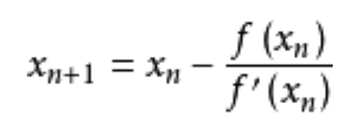
Successive approximation（连续逼近）
Newton’s method
For calculating a square root：
  1. To compute the square root of a number x, begin by making an arbitrary guess g. One possibility is just to start with g equal to x, although you can use any positive value.
  2. If the guess g is close enough to the actual square root, the algorithm is complete, and function can return g as the result.
  3. If g is not sufficiently accurate, generate a new guess by averaging the values g and x/g. Because one of these values will be less than the actual square root and the other will be larger, choosing the average allows you to pick a value that is closer to the correct answer.
  4. Store the new guess in the variable g, and repeat the process from step 2.

Slide 21
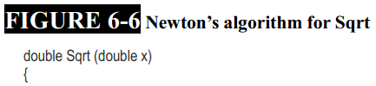
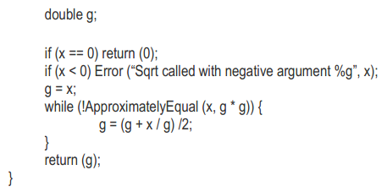
Successive approximation（连续逼近）
bool ApproximatelyEqual(double x, double y)
{
double num, den;
num = fabs(x - y);
den = MinF(fabs(x), fabs(y));
if (num + den == num) return (x == y);
return (num / den < Epsilon);
}

Slide 22
Successive approximation（连续逼近）
Reporting errors：
  The programs in this text use the Error function, which is defined in the genlib library, to report error conditions to the user. The Error function takes a control string followed by additional arguments, just as printf does. When Error is called, it displays the string “Error: ” followed by the control string, substituting values in place of format code in the same way that printf does. At the end of the line, Error automatically includes a newline character to move the cursor to the beginning of the next line.
  The main difference between Error and printf is that Error does not return to its caller. Once the error message has been displayed, the entire program terminates, just as if it had finished executing all the statements in the main program. Thus, if Sqrt were called on the value –1, the following output would appear on the screen:
  Error: Sqrt called with negative argument -1

Slide 23
6.4 Series expansion（级数展开）
While Newton’s method is a reasonable approach to the problem of calculating square roots, there are many alternative algorithms that are just as effective, some of which are easier to apply in other contexts.
One of the most widely used methods is series expansion, in which the value of a function is approximated by adding together terms in a mathematical series.
If the addition of each new term brings the total closer to the desired value, the series converges, and you can use that series to approximate the result.

Slide 24

Zeno’s paradox （Zeno悖论）
Imagine that you are trying to move across a room. To do so, you must first go halfway across it. From there, you must go half of the remainder, which means covering another quarter of the original eighth of the total, and so on. Since the remaining distance is always a quantity that can be halved, Zeno argued, the process must continue on forever, and you can never actually reach your goal. This argument is known as Zeno’s paradox.
Translate Zeno’s problem into a more mathematical form, the total fraction of the distance covered can be expressed as the following sum:

Slide 25

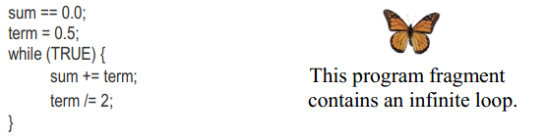
Zeno’s paradox （Zeno悖论）
Write a program to compute an approximation to the series：
  simply by adding up the terms. If you number each term starting from 2, the ith term is the sum has the form
  (power series)
The program fragment:

Slide 26
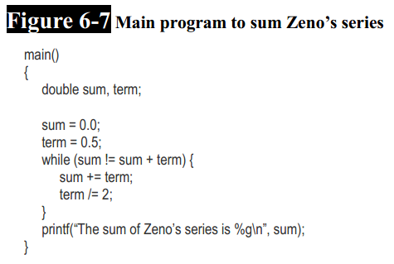
Zeno’s paradox （Zeno悖论）
Replace the while control line in the infinite loop with
while (sum!= sum + term)
the loop will continue as long as adding term to sum produces some noticeable effect.

Slide 27

Using a series expansion for the square root function
The Taylor series expansion for approximating any function-Taylor’s formula :
Taylor’s formula for the square root function:

Slide 28
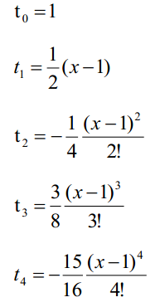


Using a series expansion for the square root function
➔
➔

Slide 29
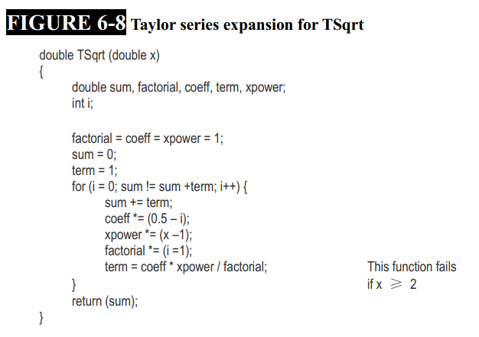
Using a series expansion for the square root function

Slide 30
Staying within the radius of convergence
As a Taylor series expansion, the formula for the square root function is effective only when the argument falls within a limited range that allows the calculation to converge. That range is called the radius of convergence.
For the square root function calculated using a = 1, the Taylor series formula requires that x be in the range:
0 < x <2
If x falls outside of the radius of convergence, the terms in the expansion keep getting bigger, and the Taylor series just gets farther and farther from the answer. This restriction makes the TSqrt function less useful, although it is still effective insider that range.

Slide 31

Staying within the radius of convergence
To accomplish this transformation of the problem, it is useful to remember that :
This observation provides you with the tools you need to complete the solution. If you have a number that is too large, you can always divide it by 4, use TSqrt to take the square root of what remains, and then multiply that result by 2. If a single division by 4 is not sufficient to bring the number into the desired range, you can divide by 4 several times before calling TSqrt, as long as you remember to multiply the result by 2 just as many times.

Slide 32
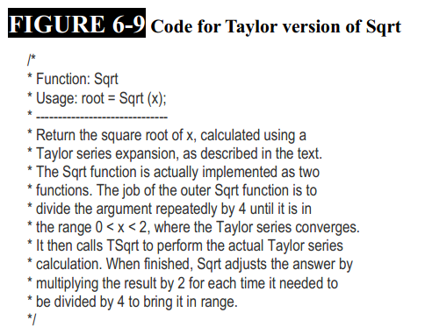
Staying within the radius of convergence

Slide 33
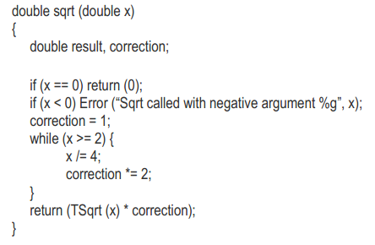
Staying within the radius of convergence

Slide 34
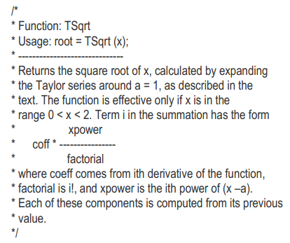
Staying within the radius of convergence

Slide 35
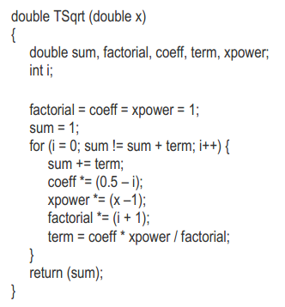
Staying within the radius of convergence

Slide 36
6.5 Specifying the size of numeric
When you are working on numerical applications such as those in this chapter, it is often important to be able to exercise some control over the range and precision of the numeric data types. To some extent, these characteristics are determined by the hardware, since all data values within a computer are stored electronically in its memory system.
Depending on the type of computer, the individual units into which memory is divided can be of different sizes. From the programmer’s point of view, the major impact of these variations in internal structure is that the numeric data types may be subject to different limitations on different machines, making it more difficult to write programs that are portable（可移植的）. A portable program is one that can be run successfully on many different computer systems in exactly the same from.

Slide 37
Integer types
Type size:
Type Mem. occupation Value ranges
  int 2 or 4 bytes -2^{n-1}~2^{n-1}-1 (n=16 or 32)
  short int (short) 2 bytes -32768~32767
  long int (long) 4 bytes -2147483648~2147483647
Format print out:
int ix; printf(“%d”, ix);
short sx; printf(“%hd”, sx);
long lx; printf(“%ld”, lx);

Slide 38
Unsigned integer types
Type size:
Type Mem. occupation Value ranges
  unsigned int 2 or 4 bytes 0~2^{n}-1 (n=16 or 32)
  unsigned short 2 bytes 0~65535
  unsigned long 4 bytes 0~ 4294967295
Format print out:
unsigned int uix; printf(“%u”, uix);
unsigned short usx; printf(“%hu”, usx);
unsigned long ulx; printf(“%lu”, ulx);

Slide 39
Floating-point types
Type size:
Type Mem. Occupation Value rangs
  float 4 bytes ±(10⁻³⁸ ~ 10³⁸ )
  double 8 bytes ±(10⁻³⁰⁸ ~ 10³⁰⁸ )

Slide 40
The End.

